Slide 1
How to use an indication rule to retrieve all records which do or do not have a 336 and a 337 and a 338 field
Yoel Kortick – Senior Librarian

Slide 2
  Introduction
  The specific indication rules to create
  Create a set to filter with the indication rules
  Filter the set using the indication rules
  Viewing the results

Slide 3


Introduction

Slide 4
Introduction
In this presentation we will use an indication rule to get all records which
  Do have fields 336 and 337 and 338
  Do not have fields 336 and 337 and 338
This presentation assumes that the user already knows how to create and test an indication rule.
For information on creating and testing indication rules see:
  Creating Indication Rules
  Testing Indication Rules

Slide 5

The specific indication rules to create

Slide 6
The specific indication rules to create
Both of the indication rules which we will use here are also located in the developer network blog post Alma Indication Rule Examples.
The blog post Alma Indication Rule Examples should be used as a guide for creating new indication rules, as it lists many examples on which new rules can be based.

Slide 7
The specific indication rules to create
This rule will be ‘true’ if the record does have a 336 and a 337 and a 338 (has all three fields)
rule "Retrieve all records which contain a 336 and a 337 and a 338 field"
when
((exists "336") AND (exists "337") AND (exists "338"))
then
set indication."true"
end

Slide 8
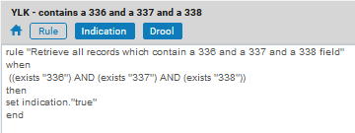
The specific indication rules to create
We have called this rule “YLK - contains a 336 and a 337 and a 338”

Slide 9
The specific indication rules to create
This rule will be ‘true’ if the record does not have a 336 and a 337 and a 338 (does not have all three fields)
rule "Retrieve all records which do not contain a 336 and a 337 and a 338 field"
when
((not exists "336") OR (not exists "337") OR (not exists "338"))
then
set indication."true"
end

Slide 10
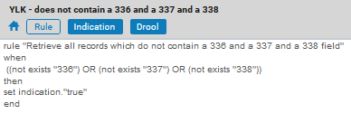
The specific indication rules to create
We have called this rule “YLK - does not contain a 336 and a 337 and a 338”

Slide 11

Create a set to filter with the indication rules

Slide 12
Create a set to filter with the indication rules
We will now create a set to filter with the indication rules.
For example
If we want to check all records in the repository which do or do not have a 336 and a 337 and a 388 then we can create a set based on a search of all records which have an MMSID > 0
If we want to check all records created in 2021 or later which do or do not have a 336 and a 337 and a 388 then we can create a set based on a search of all records which have a creation date greater than Dec. 31 2020

Slide 13
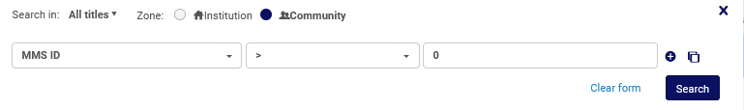
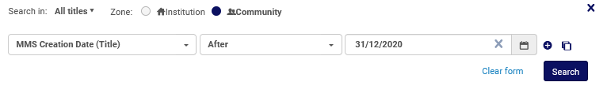
Create a set to filter with the indication rules
This “All Titles” “Advanced Search” will retrieve all records in the repository
This “All Titles” “Advanced Search” will retrieve all records which have a creation date greater than Dec. 31 2020

Slide 14
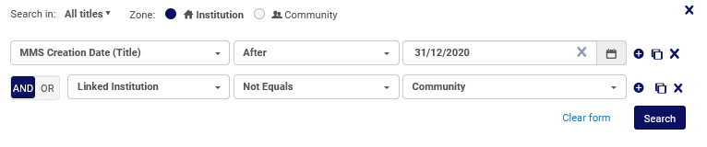
Create a set to filter with the indication rules
This “All Titles” “Advanced Search” will retrieve all records which have a creation date greater than Dec. 31 2020 and are not linked to the Community Zone

Slide 15
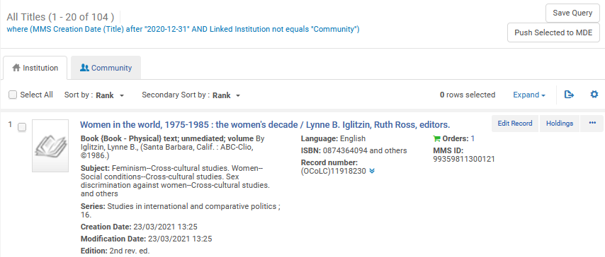
Create a set to filter with the indication rules
Save the query as a set

Slide 16
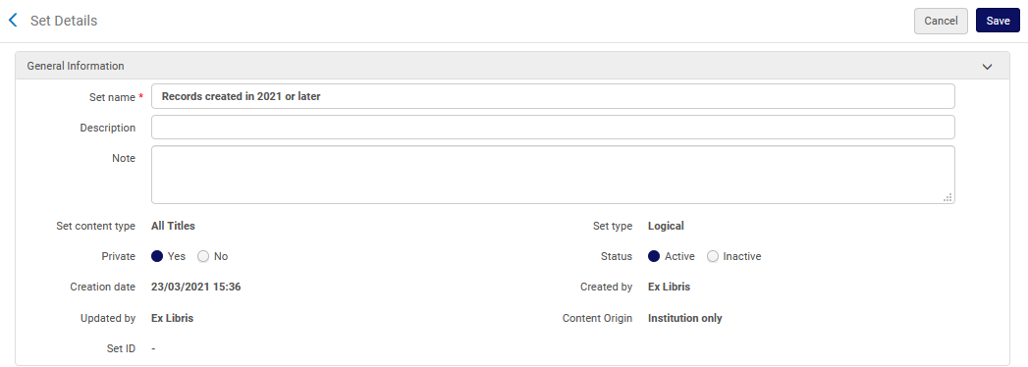
Create a set to filter with the indication rules
We are calling our set “Records created in 2021 or later”

Slide 17

Filter the set using the indication rules

Slide 18
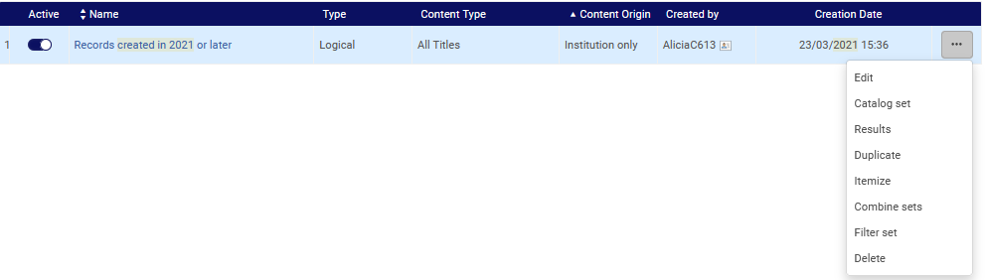
Filter the set using the indication rules
From the “Manage Sets” page find the set and filter it

Slide 19
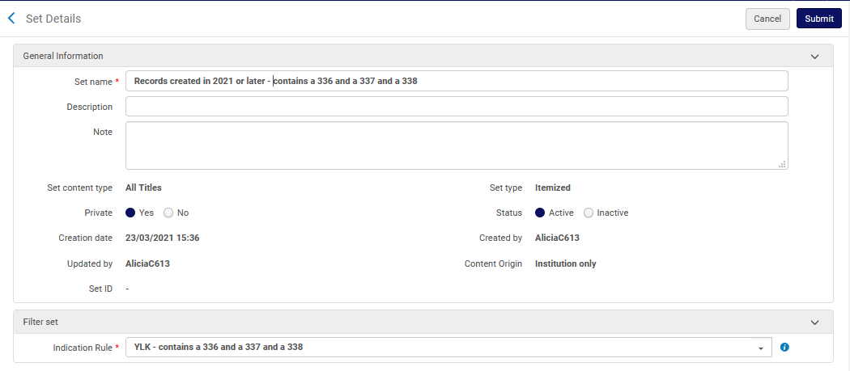
Filter the set using the indication rules
Submit the job
We will call the new resulting set “Records created in 2021 or later - contains a 336 and a 337 and a 338”
We filter using indication rule “YLK - contains a 336 and a 337 and a 338”

Slide 20
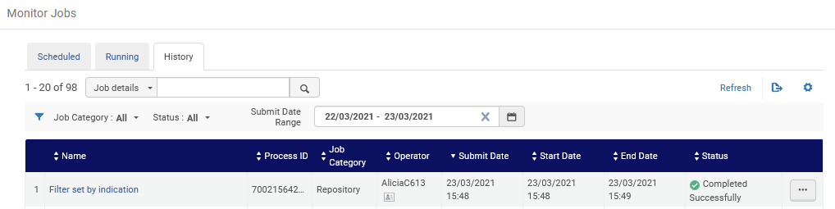
Filter the set using the indication rules
A workflow job called “Filter set by indication” runs

Slide 21
Filter the set using the indication rules
On the next slide we see that we will now again filter the set, but this time we will filter to get all records which do not have a 336 and a 337 and a 338.

Slide 22
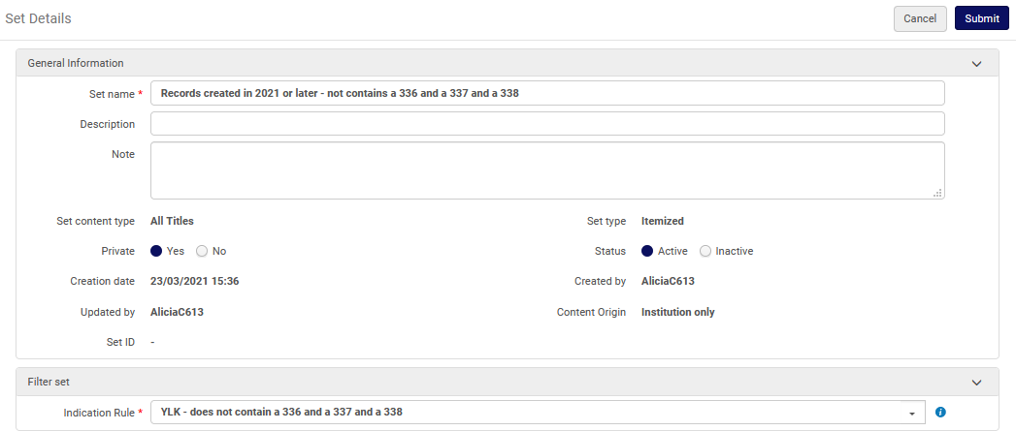
Filter the set using the indication rules
Submit the job
We will call the new resulting set “Records created in 2021 or later – not contains a 336 and a 337 and a 338”
We filter using indication rule “YLK – does not contain a 336 and a 337 and a 338”

Slide 23
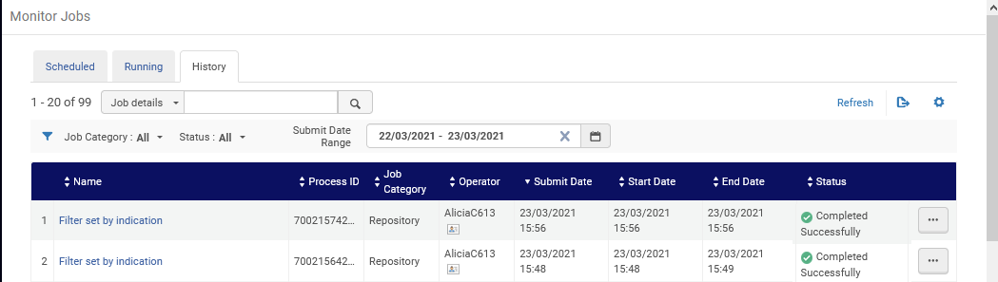
Filter the set using the indication rules
Again a workflow job called “Filter set by indication” runs

Slide 24

Viewing the results

Slide 25
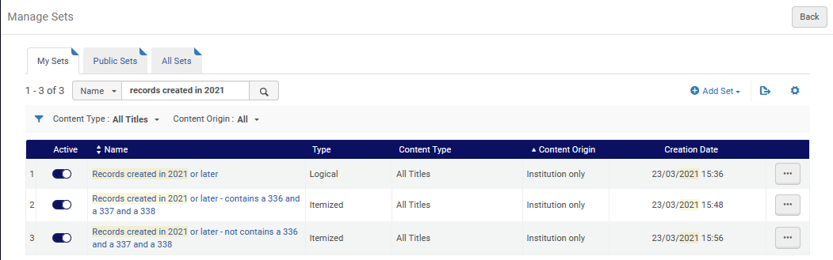
Viewing the results
Here are the two new sets which have been created

Slide 26
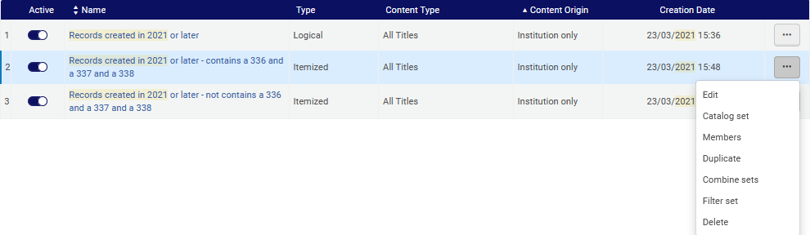
Viewing the results
Let’s now check set “Records created in 2021 or later - contains a 336 and a 337 and a 338”

Slide 27
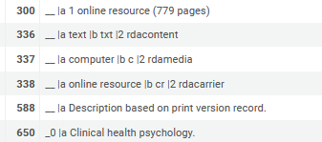
Viewing the results
All records have a 336 and a 337 and a 338

Slide 28
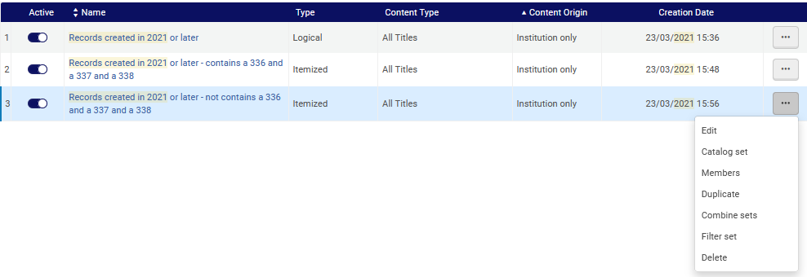
Viewing the results
Let’s now check set “Records created in 2021 or later – not contains a 336 and a 337 and a 338”

Slide 29
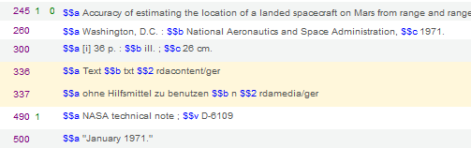
Viewing the results
All records do not have a 336 and a 337 and a 338. This one for example has a 336 and a 337 but not a 338

Slide 30
xxx@exlibrisgroup.com

